Slide 1
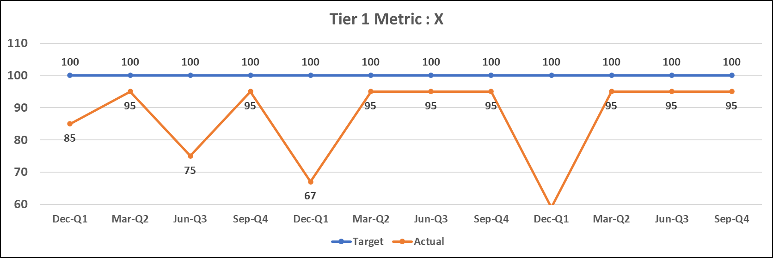
Bowler Chart: T#, driver
The targets should lead to the Current Year goal. Any changes to the goal require VCNO approval.
Sub-Drivers Impacting Performance | Current Understanding of Sub-Drivers Impacting Performance | Analytic Agenda LOE # | Gap Closure LOE # (if applicable)
T#, Driver | Quantification of sub-driver impact on driver performance (Best Practice: include bowler(s) for the sub-driver(s) to provide detailed context on the factors impacting performance) | XX | XX
Ex: T4, Stock on Hand Wholesale | Ex: For June 2025, most of the X% gap between Target and Actual can be attributed to possible wholesale shortfalls at time of demand (SOH Wholesale) and demand exceeding authorized allowance (GLS/ACR)
Notes:
Description: Bowler charts for all Tier 1, Tier 2, and any red metrics (including a visual representation of the data in the bowlers)
Purpose: Provide an in-depth look into the performance over time of key drivers along with future targets in both bowler and graphical format in order to capture the actual specific measurements and allow for easy trend visualization

